Slide 1
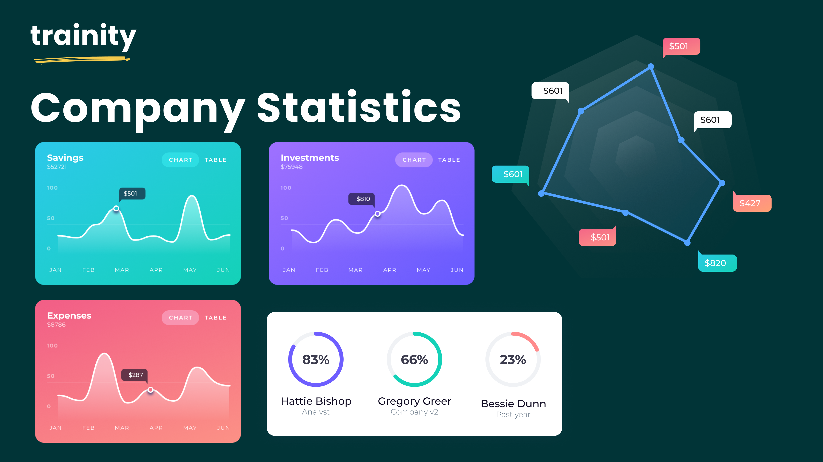
Hiring Process Analytics
Statistics
By Anindya Das

Slide 2
Project description:
As a data analyst at a multinational company like Google, you analyze the hiring process data to extract valuable insights. Understanding trends in rejections, interviews, job types, and vacancies can help improve the hiring department. You will analyze a dataset of previous hires and answer specific questions to enhance the company's hiring process.

Slide 3
Approach:
The project employs a systematic approach to Exploratory Data Analysis (EDA) by examining data columns, checking for missing values, consolidating multi-category columns, and addressing outliers. Utilizing statistical knowledge and Excel formulas, the goal is to uncover insights into the company's hiring trends. The final report will provide actionable recommendations for the hiring department, enhancing decision-making and improving the hiring process.

Slide 4

Tech stack used:
The primary tech stack for this project will be Excel, which provides a comprehensive range of functions for data analysis and manipulation. It is ideal for exploratory data analysis and insights generation. Key features like formulas, pivot tables, and charts will be used for data cleaning, calculating statistics, identifying trends, and visualizing hiring data, all through a user-friendly interface.
Microsoft Excel

Slide 5
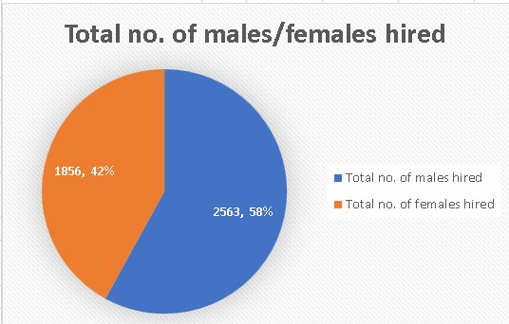
Hiring Analysis:
*Insight : The company has hired more males (2563) than females (1856). To ensure equitable hiring practices, a gender diversity review may be conducted.

Slide 6
Salary Analysis:
*Insight : The average salary in the company is $49,752.90. To attract and retain top talent, the company should evaluate whether this aligns with industry standards and competitors. If it's significantly lower, they may need to reconsider their compensation packages.

Slide 7
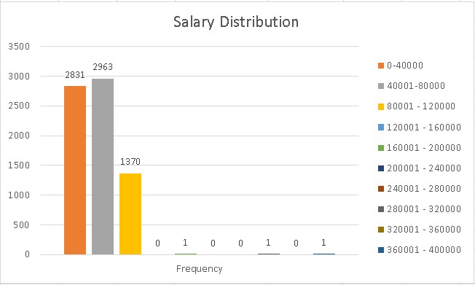
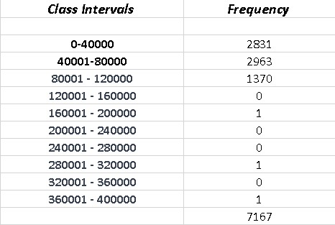
Salary Distribution:
*Insight : Most employees have salaries between $0 and $80,000. The company can analyze this data to assess salary distribution and make adjustments to ensure fair and competitive compensation, particularly for underrepresented roles in certain salary ranges.

Slide 8
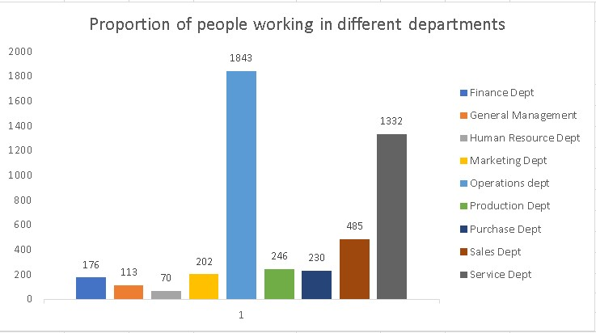
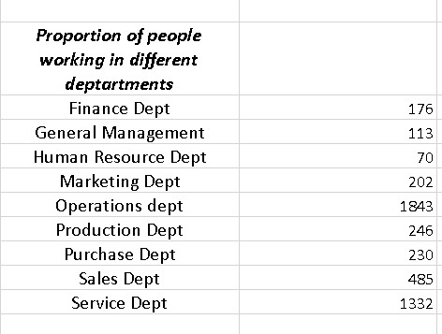
Departmental Analysis:
*Insight : Most employees are in the "Operations" and "Service" departments. The company should assess departmental distribution and enhance recruitment or incentives to attract talent in other areas.

Slide 9
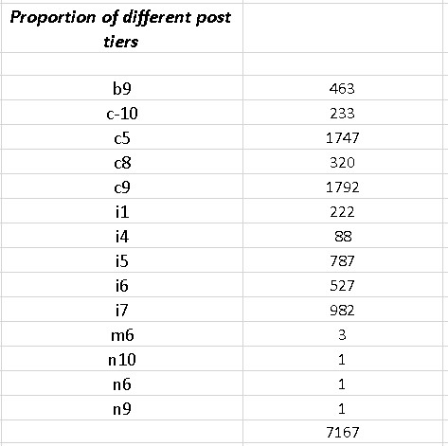
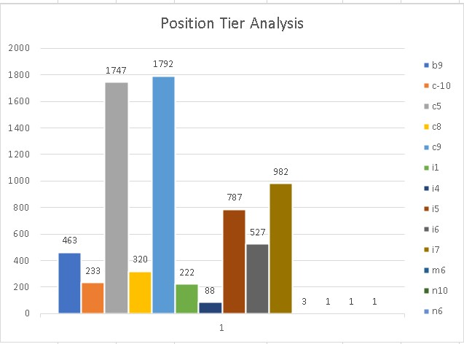
Position Tier Analysis:
*Insight : Most employees are in the "c9" post tier, followed by "i7" and "c5." This data can help the company assess workforce structure, ensure career progression, and evaluate alignment with growth plans.

Slide 10
Result
Throughout this project, I achieved key accomplishments by analyzing hiring data to determine the number of males and females hired and calculating the average salary. I also created salary ranges and visualized the data with charts and graphs to show departmental proportions and job tiers. This experience enhanced my skills in data analysis and visualization and strengthened my capabilities as a data analyst.
Link to dataset : https://docs.google.com/spreadsheets/d/1Uui2NaxdQf7kelo1eya_mcVygr-zBr9I/edit?usp=sharing&ouid=100865564169059724511&rtpof=true&sd=true

Slide 11
THANK YOU!

